Slide 1
Artificial Intelligence Programming in Prolog

Slide 2
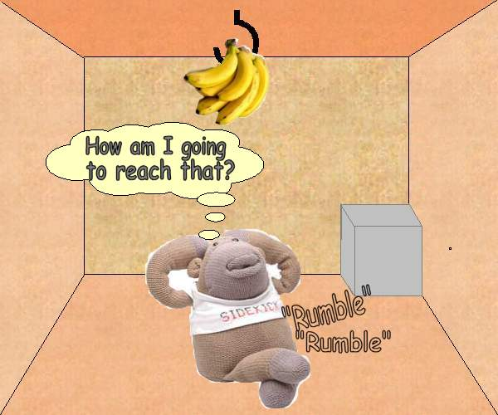
Monkey & Bananas
There is a monkey at the door into a room. In the middle of the room a banana is hanging from the ceiling. The monkey is hungry and wants to get the banana, but he cannot stretch high enough from the floor. At the window of the room there is a box the monkey may use.

Slide 3
The monkey can perform the following actions:
Walk on the floor,
Climb the box,
Push the box around (if it is already at the box) and
Grasp the banana if standing on the box directly under the banana.
Can the monkey get the banana??

Slide 4
Initial State of Monkey World
(1) Monkey is at door.
(2) Monkey is on floor.
(3) Box is at window.
(4) Monkey does not have banana.

Slide 5
prolog structure: structName(val1, val2, ... )
state(MonkeyHorizontal, MonkeyVertical, BoxPosition, HasBanana)
MonkeyHorizontal-atdoor / onfloor / atwindow / middle
MonkeyVertical-onbox/onfloor
BoxPosition-atdoor / onfloor / atwindow / middle
HasBanana-has,hasnot

Slide 6
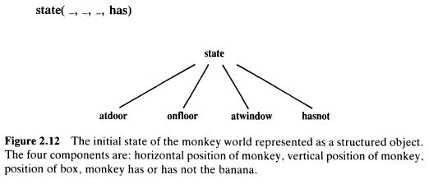

Slide 7
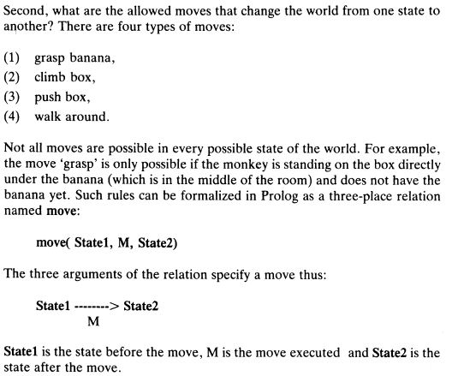

Slide 8
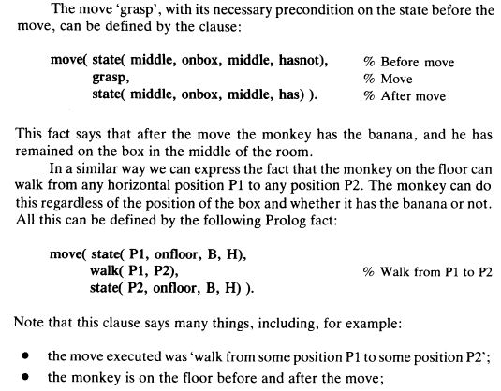

Slide 9
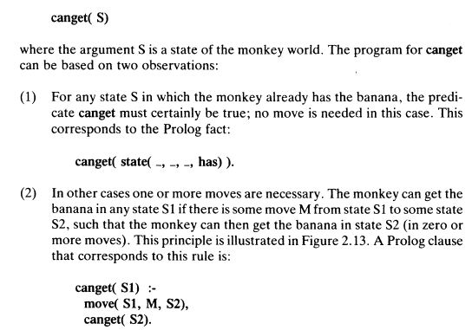
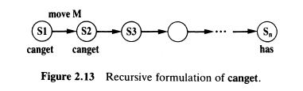

Slide 10
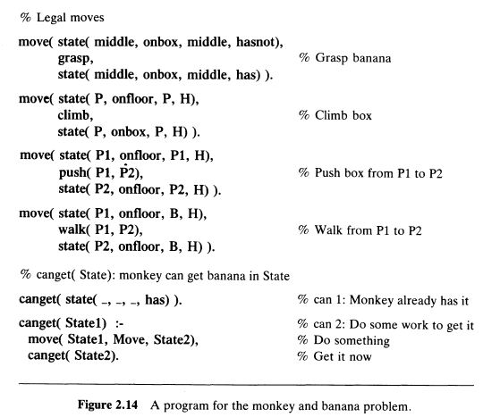

Slide 11
